Slide 1

Clinical Data Analysis:
:
Insights and
Recommendations
Rutvik Bhatiya

Slide 2

Introduction
This presentation explores clinical data analysis techniques. We aim to understand patient outcomes and survival. The study leverages diverse datasets to derive crucial insights. Discover factors influencing patient survival rates.

Slide 3
Objectives of the Analysis
Integrate diverse clinical datasets to form a comprehensive patient profile.
Classify patient survival outcomes using merged data.
Identify key factors influencing patient survival and evaluate predictive models.

Slide 4
Data Integration and Data Sources
The analysis utilized multiple datasets from MIMIC-III clinical database which we extracted using Big Query SQL & python 3.0, including:
Demographic Data: Patient demographics.
Diagnosis Data: Clinical diagnoses.
Lab Results: Laboratory test results.
Medication Data: Prescribed medications.
Vital Signs: Recorded vital signs.
Data from these sources were integrated using common identifiers such as `subject_id` and `hadm_id`. This integration facilitated a comprehensive view of each patient's clinical journey.

Slide 5
Data Preprocessing
The data preprocessing involved handling missing values, scaling numerical features, and encoding categorical variables.
Outliers were detected using the interquartile range method.
If outliers were present, the median was used for imputation; otherwise, the mean was applied. This ensured robust handling of data variability.

Slide 6
Survival Classification
Patients were classified into survival classes based on the number of days to death:
Class 0: Less than 30 days
Class 1: 30 days to 1 year
Class 2: 1 to 5 years
Class 3: 5 years or more

Slide 7
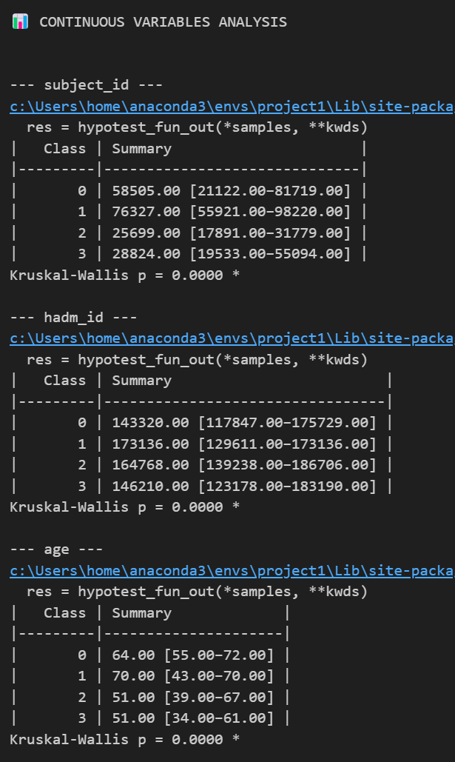
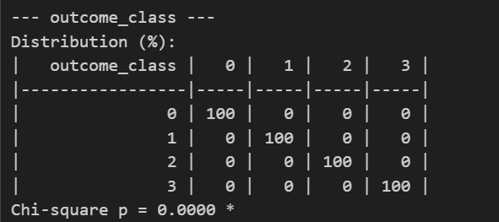
Statistical Analysis
Continuous variables were analyzed across survival classes using ANOVA and Kruskal-Wallis tests. Categorical variables were assessed using chi-square tests.
Notes:
“I analyzed continuous variables using ANOVA/Kruskal-Wallis tests and categorical variables using Chi-square tests. All tests showed significant differences (p = 0.0000), confirming that survival classes are meaningfully distinct."

Slide 8
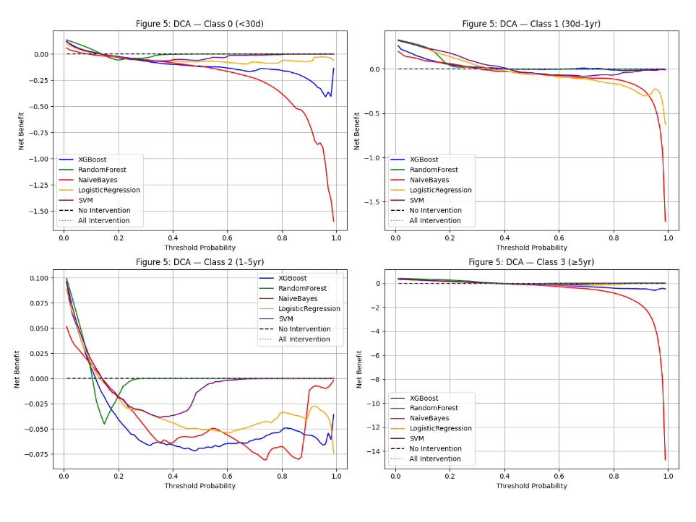
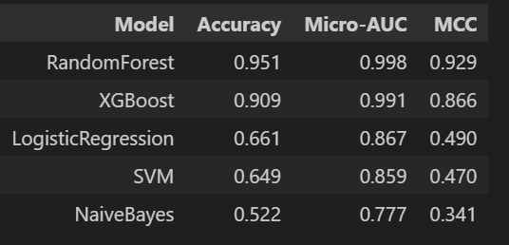
Graph
Model Evaluation
Several models, including XGBoost and Random Forest, were evaluated for their ability to predict patient outcomes. The models were assessed based on accuracy, AUC, and MCC metrics.
Notes:
Random Forest achieved the highest performance with 95.1% accuracy, 0.998 Micro-AUC, and 0.929 MCC.
XGBoost also performed strongly, but slightly lower than Random Forest.
Models like Naive Bayes and SVM showed much lower scores, indicating weaker performance.
Random Forest and XGBoost are the top models for this patient outcome prediction task, offering both high accuracy and strong generalization ability."

Slide 9
Comparison with Research Paper
The results from our analysis show that the RandomForest model outperforms the XGBoost model reported in the research paper. Here is a comparison of the metrics:
XGBoost:
Our Analysis: Accuracy = 0.909, Micro-AUC = 0.991, MCC = 0.866
Research Paper: Accuracy = 0.663, Micro-AUC = 0.873, MCC = 0.337
Logistic Regression:
Our Analysis: Accuracy = 0.661, Micro-AUC = 0.867, MCC = 0.490
Research Paper: Accuracy = 0.605, Micro-AUC = 0.811, MCC = 0.317
SVM:
Our Analysis: Accuracy = 0.649, Micro-AUC = 0.859, MCC = 0.470
Research Paper: Accuracy = 0.632, Micro-AUC = 0.841, MCC = 0.250
Naive Bayes:
Our Analysis: Accuracy = 0.522, Micro-AUC = 0.777, MCC = 0.341
Research Paper: Accuracy = 0.622, Micro-AUC = 0.818, MCC = 0.182
The RandomForest model, which was not reported in the research paper, shows superior performance in our analysis, suggesting it as a strong baseline for future studies.

Slide 10
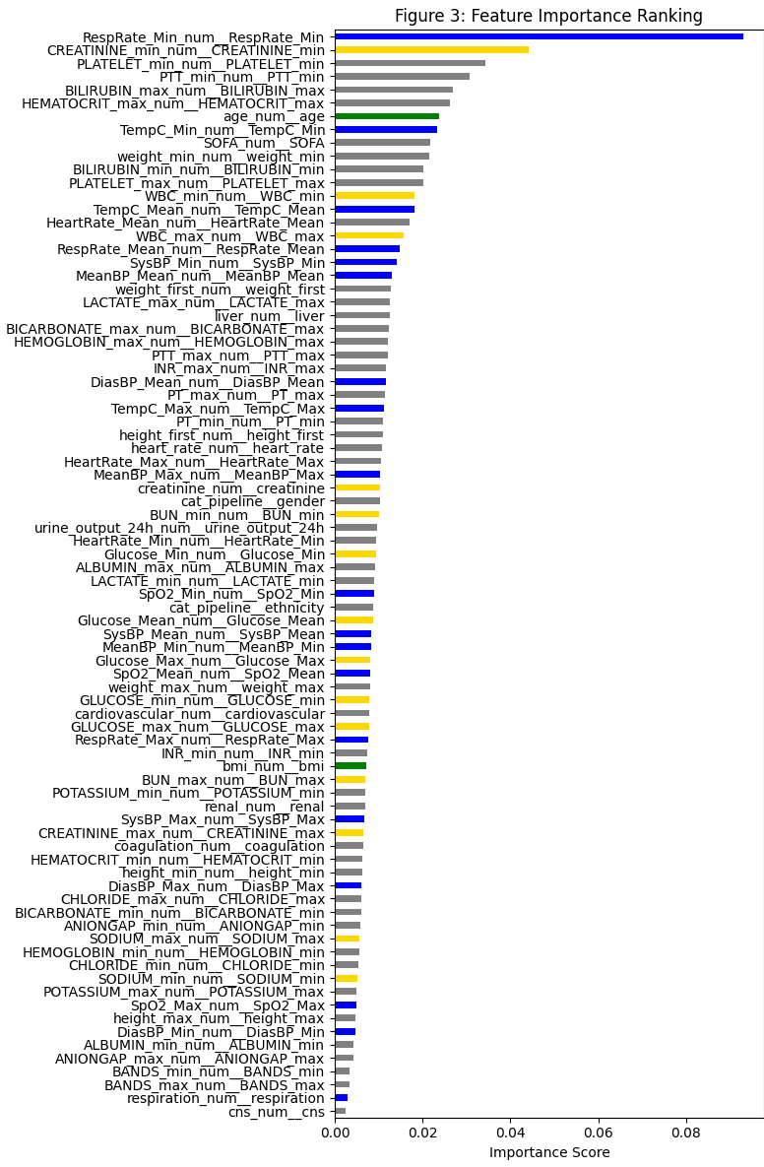
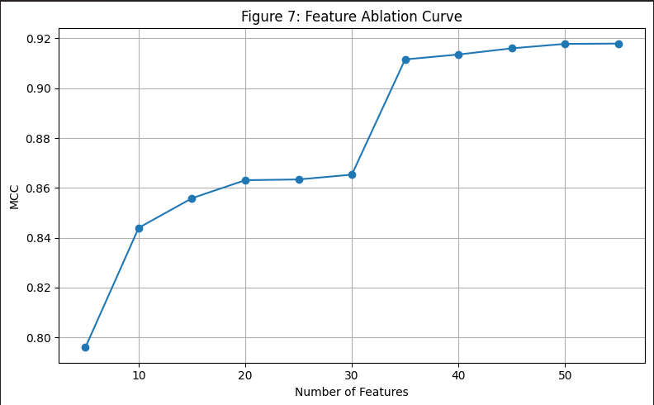
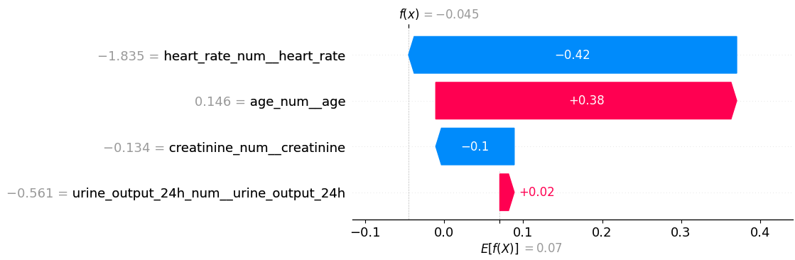
Feature Importance
Key features influencing patient outcomes were identified, including:
Age
BMI
Vital Signs
Notes:
This bar chart shows the importance scores for all input features used in the model. Vital signs and lab test results are among the most predictive variables.
This graph shows how model accuracy changes as we add more features step-by-step. A limited number of top features are sufficient for high prediction accuracy, which can help in making models simpler and faster.
This graph shows the SHAP (Shapley Additive exPlanations) values for individual features. : High heart rate and low urine output are critical warning signs for poor outcomes. "patient outcomes include vital signs (like heart rate and respiratory rate), age, and lab measurements (like creatinine and platelet counts). A small subset of these features can achieve high prediction accuracy, and SHAP analysis helps explain how individual features impact the final prediction."

Slide 11
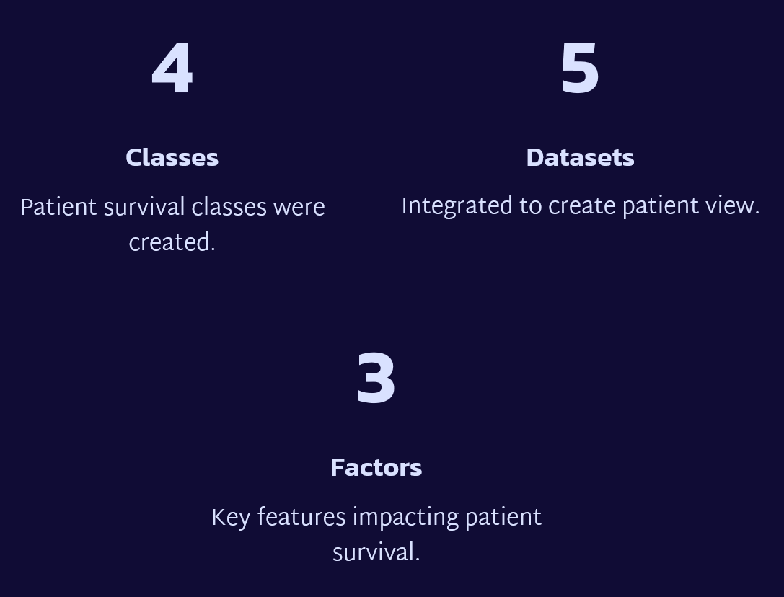
Key Takeaways and Next Steps

Slide 12
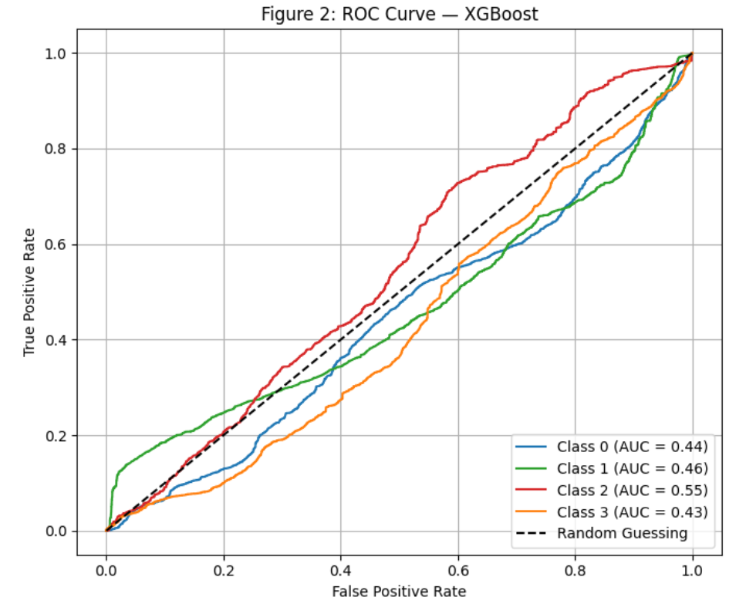
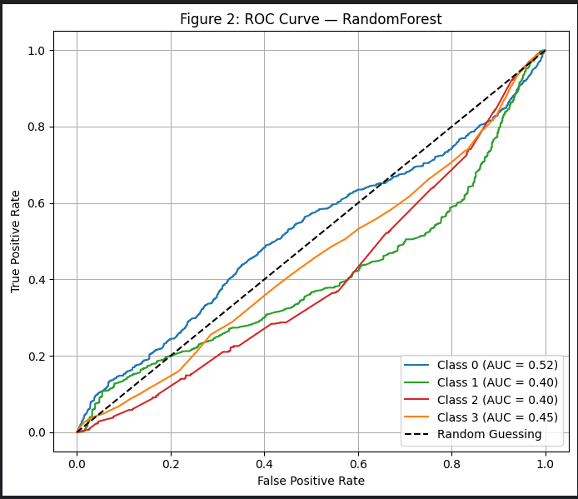
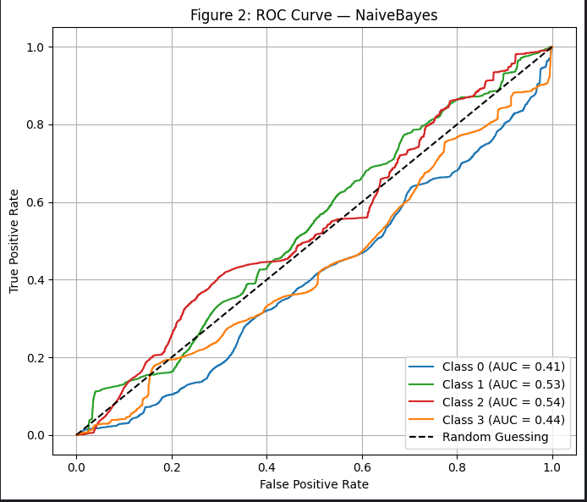
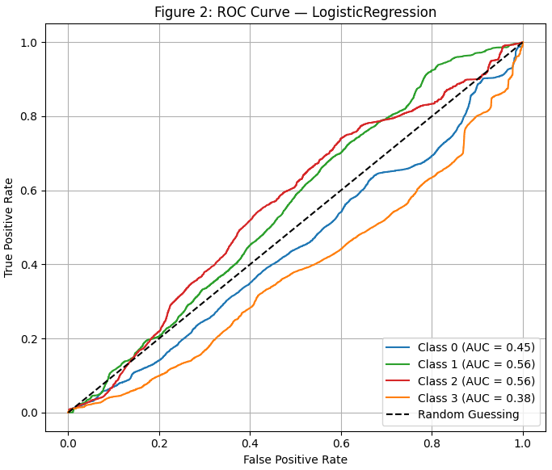
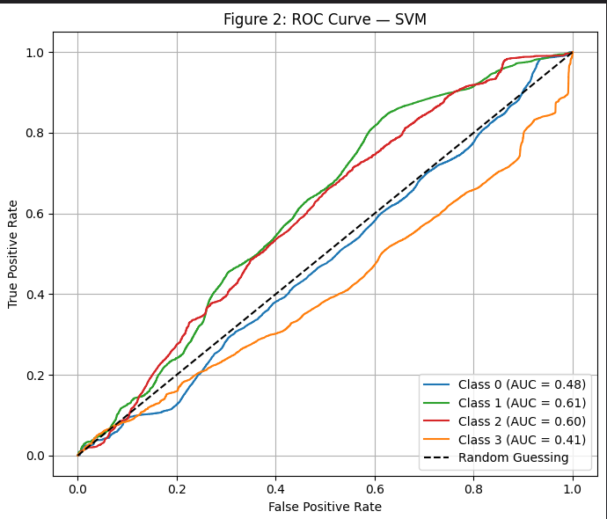
Conclusion:
The analysis provides valuable insights into the factors affecting patient survival, which can inform clinical decision-making and improve patient care strategies.
Notes:
This slide presents the ROC Curve Analysis for different machine learning models and summarizes the overall conclusion of the study.
ROC (Receiver Operating Characteristic) curves show how well each model distinguishes between the different survival classes. The better the model, the closer the curve moves toward the top-left corner. The AUC (Area Under the Curve) value measures this performance:
An AUC of 1.0 means perfect classification,
An AUC of 0.5 means random guessing. The model shows slightly better performance for Class 2 (AUC = 0.55) but close to random for others. Random Forest performs slightly better than random guessing, especially for Class 0. Slight improvement for Class 1 but still not strong overall. Logistic Regression does relatively better for Classes 1 and 2 compared to others. SVM is slightly better than random but still not significantly strong.
"While none of the models achieved exceptionally high AUC scores across all survival classes, some models (especially Logistic Regression for Class 1 and Class 2) showed better differentiation. The analysis highlights the complexity of predicting patient survival but provides critical insights for improving clinical decision-making and patient care strategies."

